Slide 1
Enrichment analysis
Coding Club
30-11-2023

Slide 2
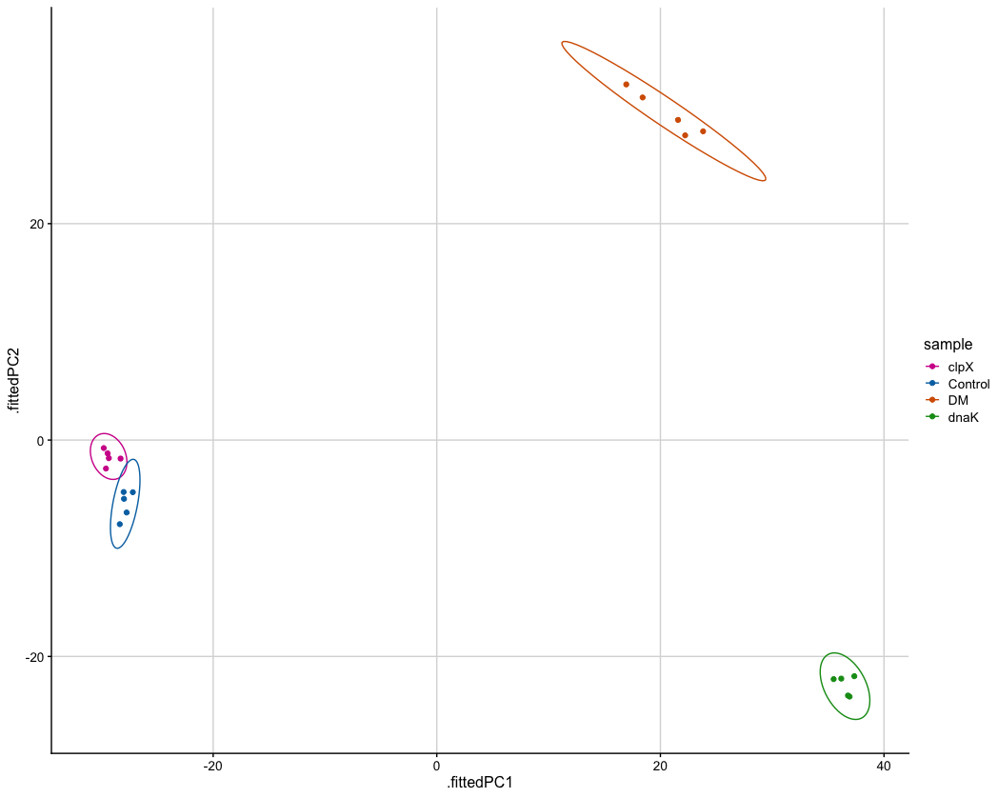
Proteomics dataset
DM
clpX
Control
dnaK

Slide 3
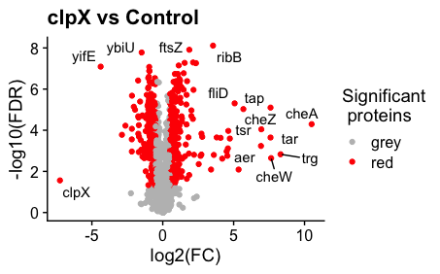
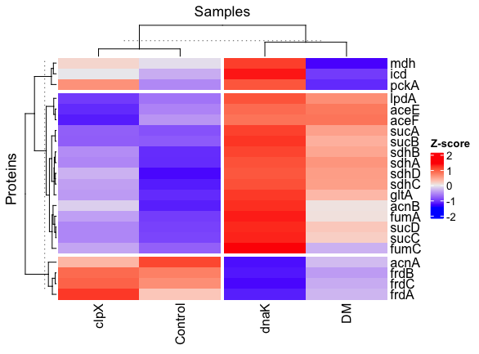
What have we done until now?
Clean the data
Remove missing values and so on
Stats
Multiple univariate T-tests with correction
Volcano plots
PCA (code not reviewed)
heatmaps

Slide 4
What is an enrichment analysis?
Why do we do it?
Why is it important?
How can we do it?
What are the possible pitfalls?

Slide 5
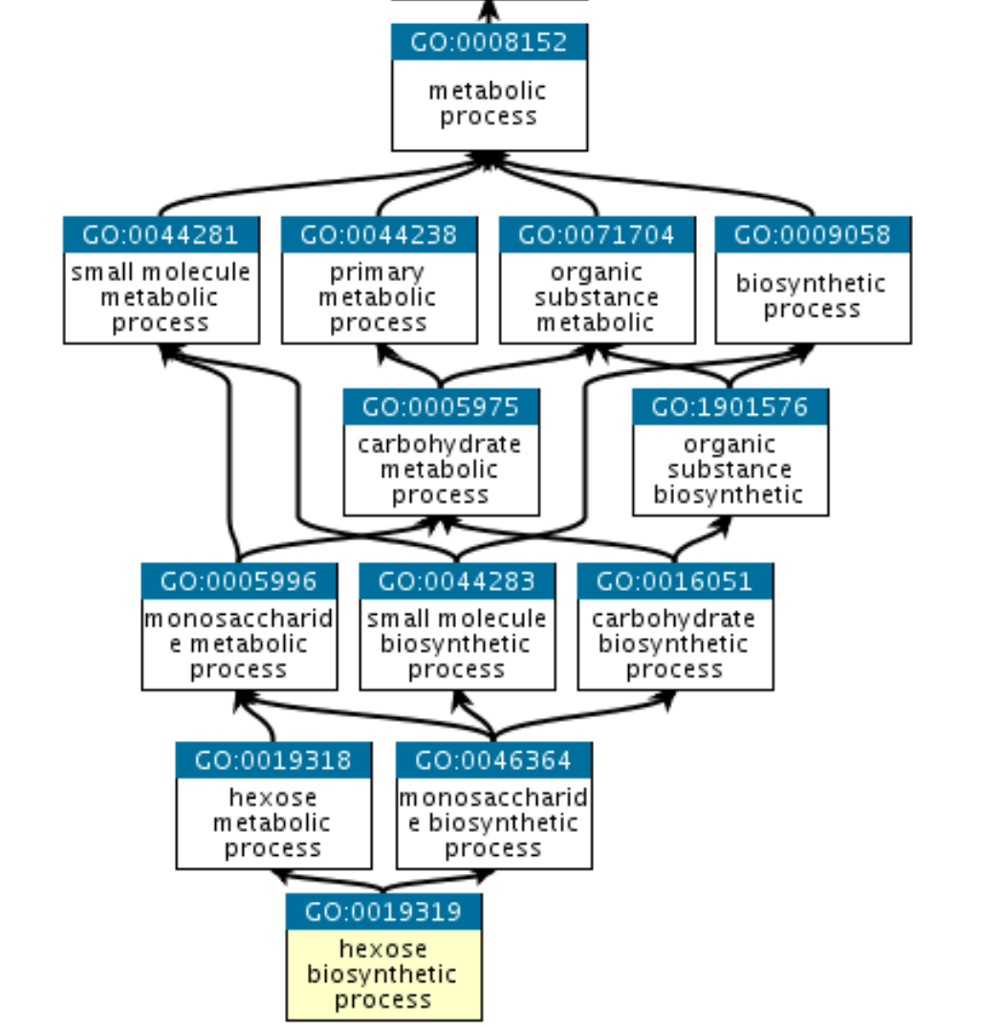
What is an enrichment analysis?
Why do we do it and why is it important?
Genes (proteins) can be grouped by functions, cell compartments or pathways
We want to see if any relevant group is more important than the others (i.e., it has more proteins being expressed or repressed)
What are the most common categories that we use?
KEGG pathways
GO terms
MF: molecular function
BP: biological process
CC: cellular compartment

Slide 6
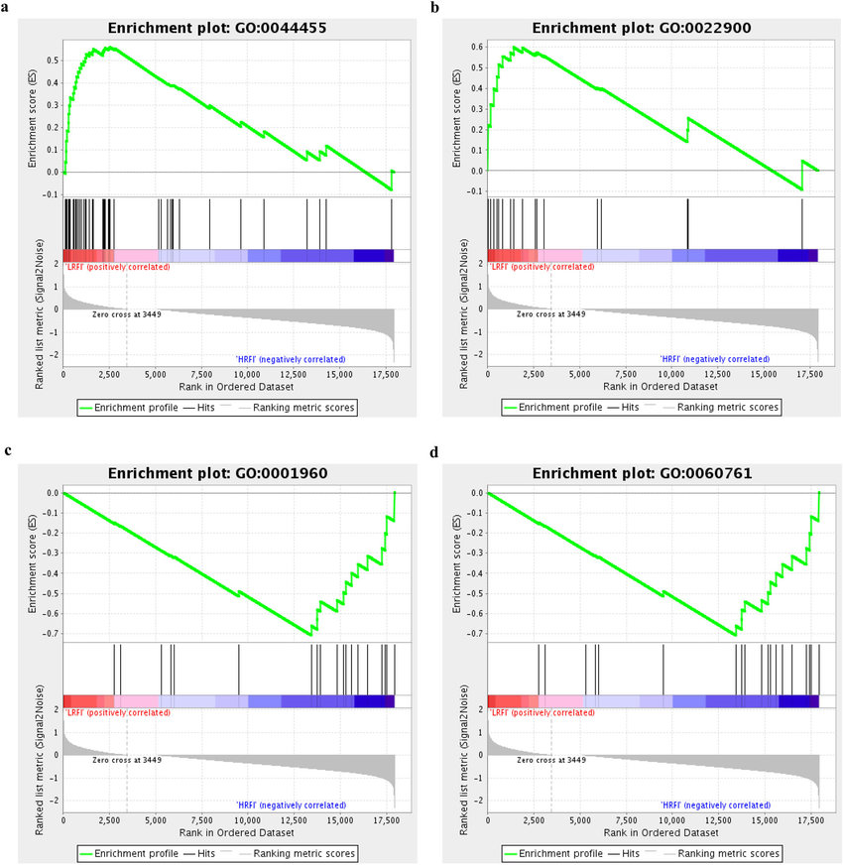
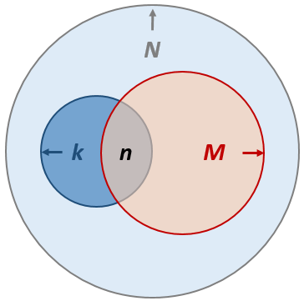
How can we do it?
GSEA (Gene set enrichment analysis)
Hypergeometric test
(Fisher’s exact test)

Slide 7
Hypergeometric test
all proteins
The hypergeometric distribution is a discrete probability distribution that describes the probability of k successes (random draws for which the object drawn has a specified feature) in n draws, without replacement, from a finite population of size N that contains exactly M objects with that feature.
We compare our results to the random draws/by chance (null hypothesis) and then get a P-value
sig. genes
genes that
belong to
cat A
successes!

Slide 8


“Universe”
Your sample

Slide 9
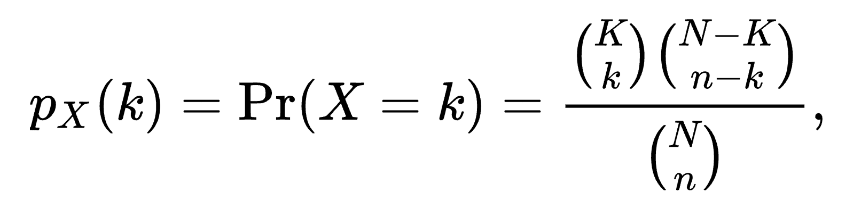
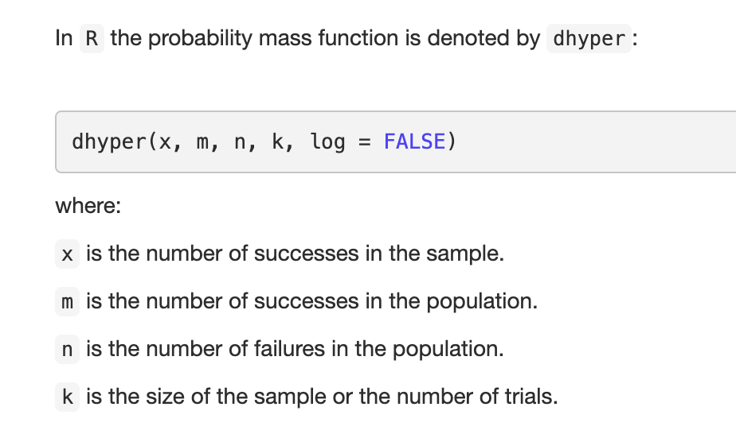
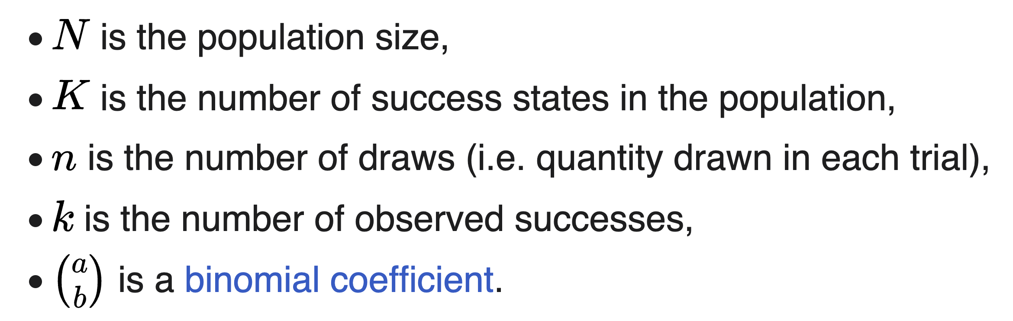
Hypergeometric distribution
Hypergeometric test in R

Slide 10
